Slide 1
Azure Batch
An Introduction

Slide 2
What is Azure Batch
Multi-processing as a service.
Run “embarrassingly parallel” workloads.
Each instance completes part of the work.
Instances do not communicate with each other, i.e. loosely coupled.
Also works with tightly-coupled workloads.

Slide 3
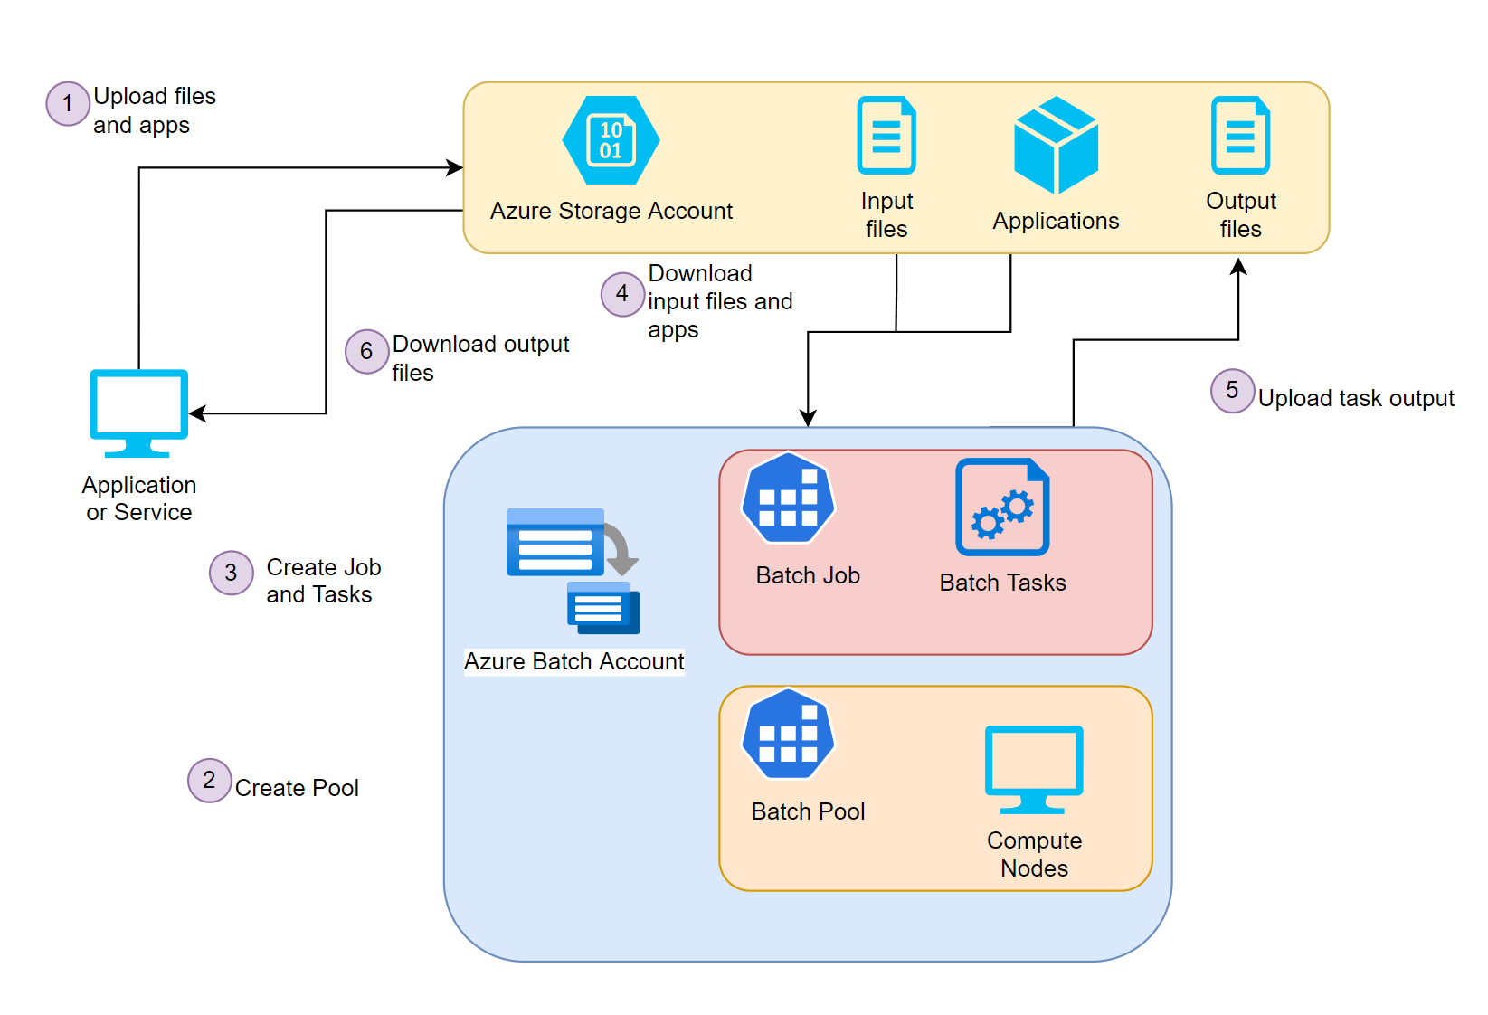
Azure Batch Components and Workflow

Slide 4
Demo - Overview
Input files: 1,000 files containing a varying number of words.
Job: Creates a task per file
Spawns a .NET Framework 5.0 console app
Does a word count
Sends the count as a message to an Azure Event Hub
Doing it on your own
Follow the steps in the README.
Github repository
https://github.com/farooq-teqniqly/yt-azure-batch

Slide 5
Demo – Resource Creation
Bicep files
Storage account and input file container
Batch account
Event hub namespace and event hub
Powershell scripts
Upload text files to input file container
Upload console app to Batch account
ASP.NET Web API
Create Batch pool, job, and tasks
Runs in a Docker container

Slide 6
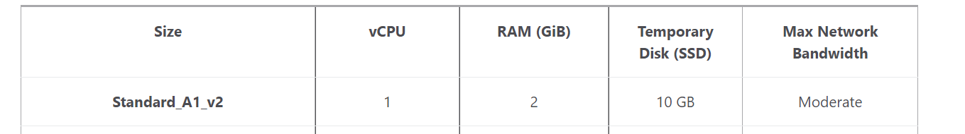
Performance
Number of nodes | Job time (minutes)
1 | 80
3 | 32
6 | 19

Slide 7
Development Tips
Use the Azure Batch client library for .NET
https://docs.microsoft.com/en-us/dotnet/api/overview/azure/batch
Publish console app as a self-contained app
No need to install the .NET Framework on compute nodes

Slide 8
Cost
Pay for virtual machines and storage.
No additional cost for Azure Batch.

Slide 9
Resources
Microsoft Learn
Run parallel tasks in Azure Batch with the Azure CLI
https://docs.microsoft.com/en-us/learn/modules/run-parallel-tasks-in-azure-batch-with-the-azure-cli/
Create an app to run parallel compute jobs in Azure Batch
https://docs.microsoft.com/en-us/learn/modules/create-an-app-to-run-parallel-compute-jobs-in-azure-batch/
Azure Batch documentation
https://docs.microsoft.com/en-us/azure/batch/

Slide 10
Thanks for watching!

